Slide 1
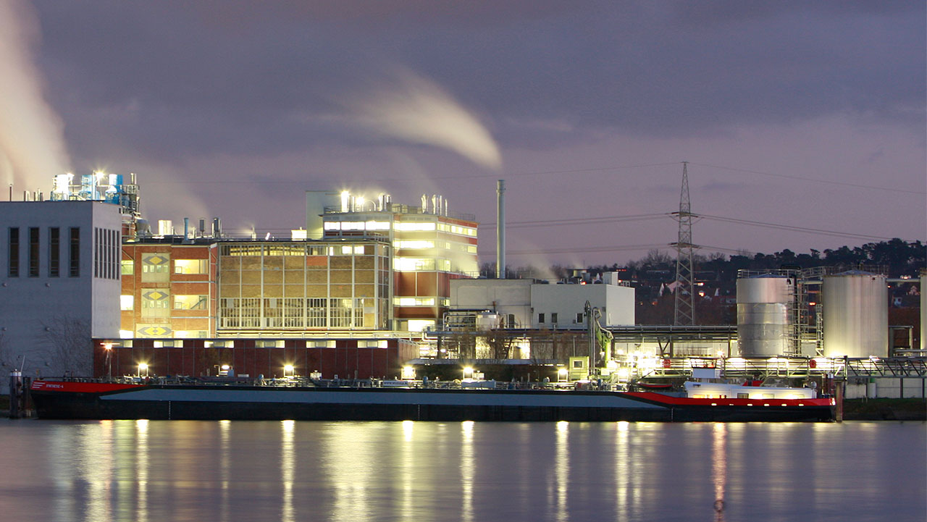








Gen2 Robusta ED (BUGA)
BEX for service lifts at high capacities
3000, 3500, 4000, 4500, 5000
x
40, 46, 53, 60, 66 passengers
Heavy freight elevators with proven Gen2 technology
75 m / 24 stops
0.5 / 0.8 / 1 / 1.6 /
1.75 m/s
Reasonable complement to
Gen2 Robusta

Slide 2
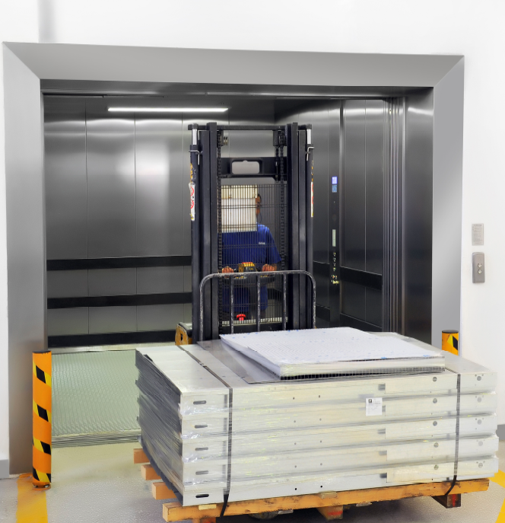
Main characteristics overview
Gen2 Robusta ED
 |  |  | Duty Load & number of passengers
 |  |  | 3000 | 3500 | 4000 | 4500 | 5000
 |  |  | 40 | 46 | 53 | 60 | 66
Speed | 0,5 / 0,8
(m/s) | 1
 | 1,6 / 1.75
Entrances |  | 1 or
 |  | 2 (180°)
Low OVH / Low Pit
Car width |  |  | 1800 ÷ 2700
Car depth |  |  | 2400 ÷ 3800
Car height |  |  | 2200 ÷ 2700
WTW (min) |  |  | 2670 (On Landing), 2795 (in Hoistway)
HW (min) |  |  | 2970
 |  |  |  | Standard |  | No scope

Slide 3
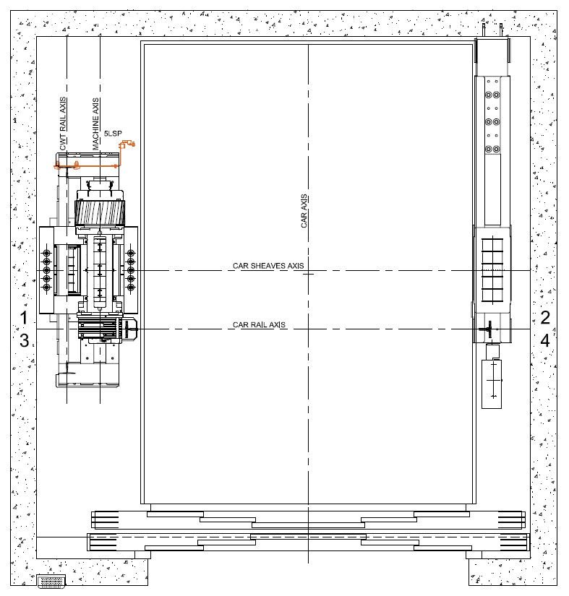
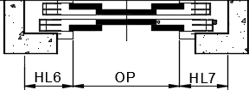
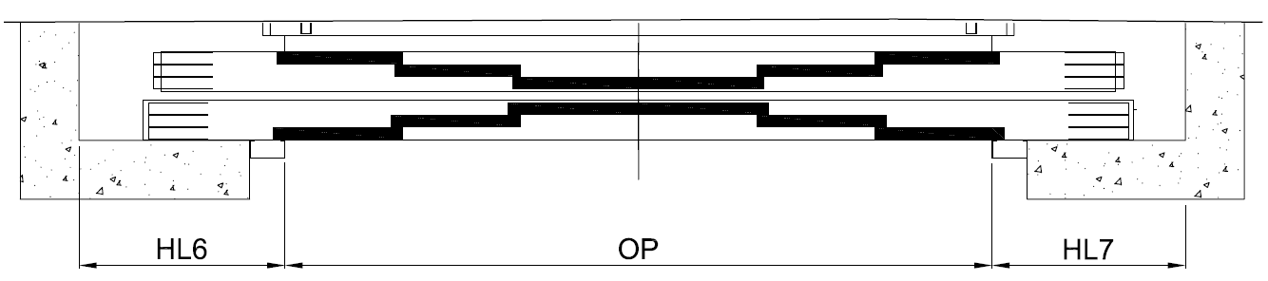
Key parameters
Gen2 Robusta ED
VARIABLE CAR DIMENSIONS
DOOR RANGE
MACHINE LOCATION
9 m²
CLD2
4 panel central
CD variable
4,32 m²
CW variable
CLD3
6 panels central
Variable car dimensions
in 50mm steps

Slide 4
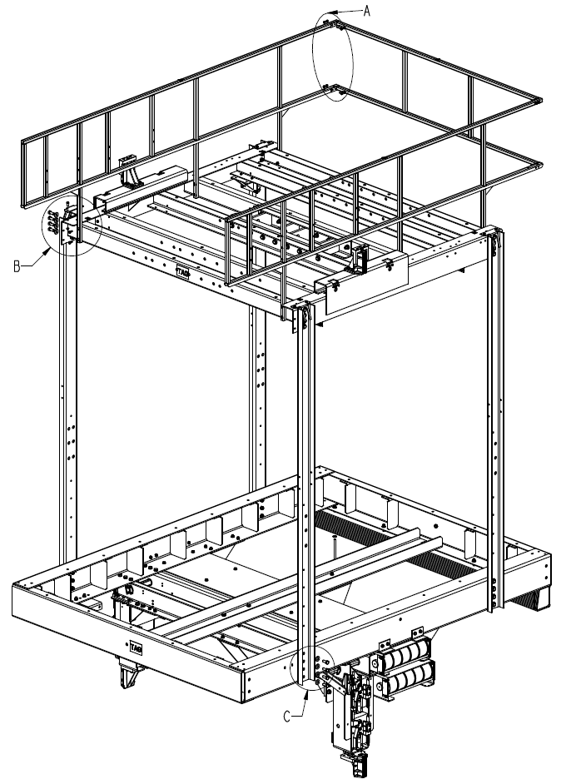
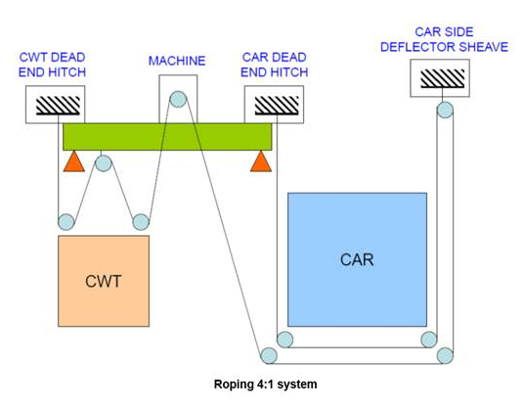
4:1 Under-slung
platform
Belts
A better ride quality
10 milli-g horizontal vibration and 53dB(A) in car
+
Robustness
All the mechanical efforts go to a full robust car frame.
+
Roping 4:1
+
Roping 4:1
This allows to have high duties with smaller components (machine, drive etc.)

